Slide 1
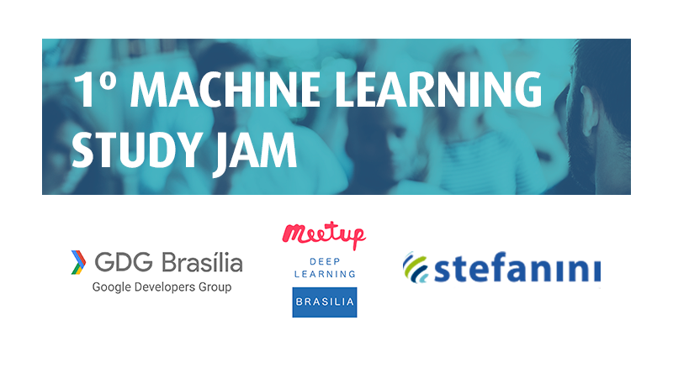


Machine Learning Crash Course Study Jam (MLCC)
Brasília - 21 de julho de 2018

Slide 2
Agenda
IA ? Machine Learning ? Deep Learning ?
Conceitos chaves do ML
Treinar um modelo de ML (TensorFlow)
Usamos o MLCC (Machine Learning Crash Course) do Google

Slide 3
30 min | Meet and Greet Make sure everyone has a laptop Prerequisites check.
10 min | Overview of MLCC Briefly explain target audience topics and scope of course modality of content (videos, docs, Playground, Colab exercises) Then watch Intro to ML module video as a group.
95 min | Discuss material together of next three modules of MLCC: Framing Descending into ML Reducing Loss Split into pairs to do the CYU and Playground exercises
15 min | Break
90 min | Watch First Steps with TF video and do the 5 exercises in the module

Slide 4
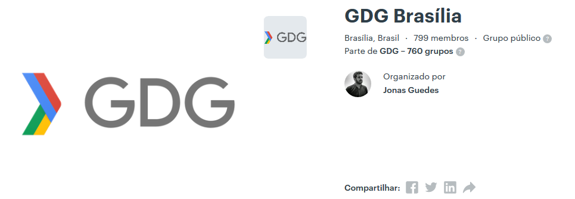
Meetup GDG
https://www.meetup.com/pt-BR/GDG-Brasilia/

Slide 5
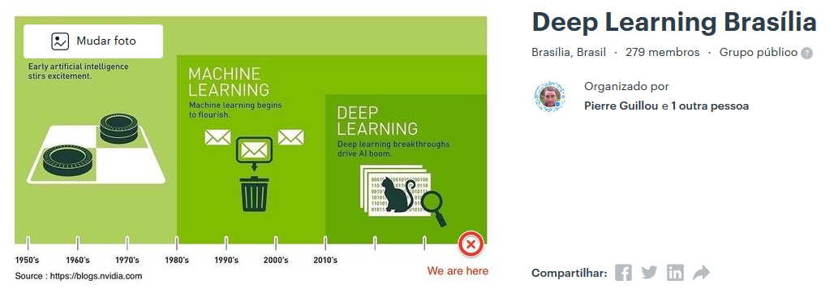
Meetup “Deep Learning Brasília”
https://www.meetup.com/pt-BR/Deep-Learning-Brasilia/

Slide 6
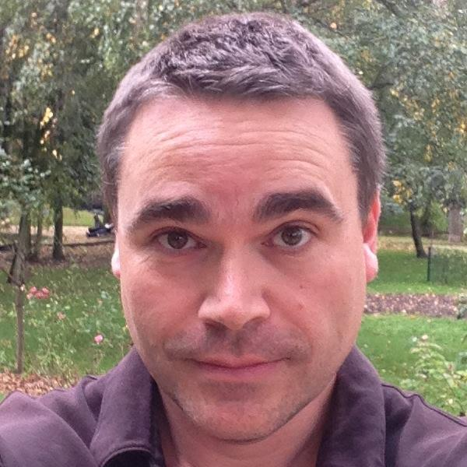




Instrutores | Pierre Guillou & Paulo Cotta
Consultor em IA & Co-organizador
dos meetups “Inteligência Artificial Brasília” & “Deep Learning Brasília”
do grupo de estudo do Deep Learning em Brasília (fórum Fastai)
do grupo de estudo dos impactos da IA na sociedade com o ICS / UnB
medium.com/@pierre_guillou
m.me/pierre.guillou.fr
@pierre_guillou
linkedin.com/in/pierreguillou

Slide 7

Instrutores | Pierre Guillou & Paulo Cotta
Desenvolvedor IA - Stefanini & Ajudante
Líder e quer muito disseminar o conhecimento em ML e DL;
Algoritmos de Deep Learning e Machine Learning no git: https://github.com/paulovpcotta.
@PauloVPCotta
linkedin.com/in/paulo-vitor-pereira-cotta

Slide 8
Vocês e a IA ?
Quantos já treinaram :
um modelo de Machine Learning ?
uma Rede Neural Artificial ?
Notes:
How many have implemented a NN ?
How many have used OpenSource Framework versus (offor online) implemented a NN from scratch ?

Slide 9
Pais da IA
… e os ensinamentos deles !

Slide 10
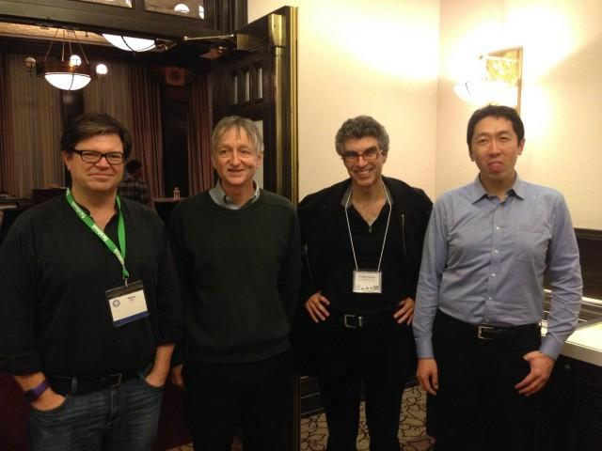

Slide 11
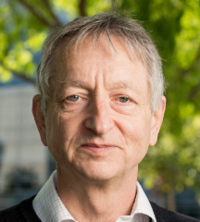
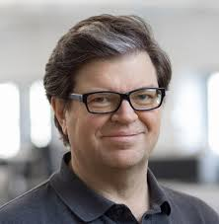
Geoffrey Hinton
1977 : Phd em IA
1986 : metodologia de treinamento dos NN (Backpropagation)
2012 : ImageNet com um NN (AlexNet)
2012 : curso Neural Networks for Machine Learning (Coursera)
2014 : palestra no MIT Geoffrey Hinton Capsule theory
2017 : cofundador do Vector Institute (Toronto)
Atualmente : professor na University Toronto + Google AI
Yann LeCun
1987 : Phd em CC com um modelo de Backpropagation (BP)
1988 : Post-Doutorado com o Geoffrey Hinton
1989 : criou a ConvNet inspirada pelo córtex visual
1998 : Yann LECUN e Yoshua BENGIO criaram LeNet-5, primeira ConvNet a ser usada (reconhecimento de números)
2013 : cofundador do colóquio em IA ICLR
2013 : primeiro director do Facebook AI Research
2015 : curso Aprendizagem profunda (Collège de France)
Atualmente : professor na University New York + Facebook AI

Slide 12
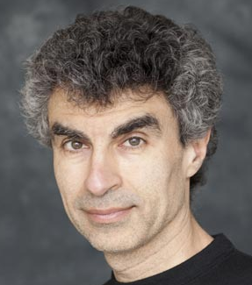
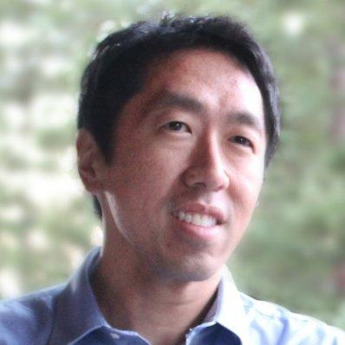
Yoshua Bengio
1991 : Phd em CC sobre os ConvNets (McGill, Montreal)
1998 : Yann LECUN e Yoshua BENGIO criaram LeNet-5, primeira ConvNet a ser usada (reconhecimento de números)
2012 : director do instituto MILA (Montreal)
2013 : cofundador do colóquio em IA ICLR
2016 : cofundador de Element AI (Montreal)
Atualmente : professor na University Montreal + Element AI
Andrew Ng
2002 : Phd em CC (Berkeley, USA)
2002 : professor de Machine Learning na University Stanford
2011 : curso Machine Learning
2011/12 : criou Google Brain no Google
2012 : cofundador of Coursera
2014/17 : director da IA em Baidu
2013 : curso DeepLearning.ai (Coursera)
2018 : lançou um Fundo de Investimento em IA
Atualmente : professor na University Stanford + DeepLearning.ai

Slide 13
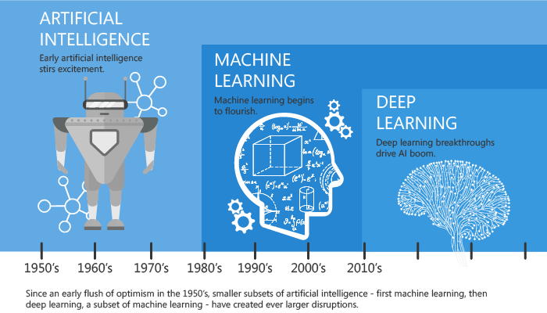
ML, DL | Técnicas para implementar a IA
Notes:
https://medium.com/@Say2neeraj/what-is-the-difference-between-machine-learning-and-deep-learning-5795e4415be9

Slide 14
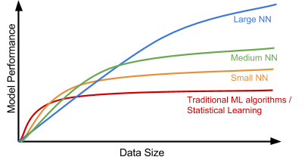
Funciona !
Notes:
But why we use DLnow ? (answer scability, cad de s’améliorer avec l’augmentation des données)
http://jaejunyoo.blogspot.com/2017/03/nips-2016-tutorial-summary-nuts-and-bolts-of-building-AI-AndrewNg.html
Here is an interesting plot presenting the relationship between the data scale and the model performance, proposed by Andrew Ng in his “Nuts and Bolts of Applying Deep Learning” talk. On a small dataset, traditional algorithms (Regression, Random Forests, SVM, GBM, etc.) or statistical learning does a great job, but once the data scale goes up to the sky, the large NN outperforms others. Partially because compared to a traditional ML model, a neural network model has many more parameters and has the capability to learn complicated nonlinear patterns. Thus we expect the model to pick the most helpful features by itself without too much expert-involved manual feature engineering.
traditional does not improve with more data (the rise of data)
why more data ? Digitalization of the society processes (big data)

Slide 15
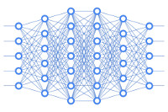
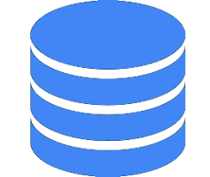

Por que hoje ?
Dados | Modelos | Computação
Notes:
But why we use DLnow ? (answer scability, cad de s’améliorer avec l’augmentation des données)
http://jaejunyoo.blogspot.com/2017/03/nips-2016-tutorial-summary-nuts-and-bolts-of-building-AI-AndrewNg.html
Here is an interesting plot presenting the relationship between the data scale and the model performance, proposed by Andrew Ng in his “Nuts and Bolts of Applying Deep Learning” talk. On a small dataset, traditional algorithms (Regression, Random Forests, SVM, GBM, etc.) or statistical learning does a great job, but once the data scale goes up to the sky, the large NN outperforms others. Partially because compared to a traditional ML model, a neural network model has many more parameters and has the capability to learn complicated nonlinear patterns. Thus we expect the model to pick the most helpful features by itself without too much expert-involved manual feature engineering.
traditional does not improve with more data (the rise of data)
why more data ? Digitalization of the society processes (big data)

Slide 16
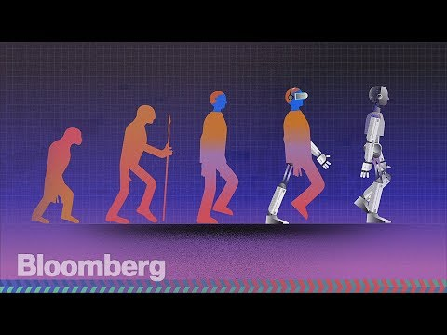
The rise of AI (51mn)
Neste episódio inovador de "Hello World", a história da ascensão da IA é contada em detalhes pela primeira vez, enquanto o jornalista Ashlee Vance se dirige ao inesperado berço da tecnologia, o Canadá.

Slide 17
Introduction

Slide 18
Objetivos
Reconhecer os benefícios práticos de usar o aprendizado de máquina :
Redução do tempo de programação
Personalização dos produtos
Executar tarefas “não programáveis”
Entenda a filosofia por trás do aprendizado de máquina (aprendizagem automática).
Link : https://developers.google.com/machine-learning/crash-course/ml-intro
Notes:
But why we use DLnow ? (answer scability, cad de s’améliorer avec l’augmentation des données)
http://jaejunyoo.blogspot.com/2017/03/nips-2016-tutorial-summary-nuts-and-bolts-of-building-AI-AndrewNg.html
Here is an interesting plot presenting the relationship between the data scale and the model performance, proposed by Andrew Ng in his “Nuts and Bolts of Applying Deep Learning” talk. On a small dataset, traditional algorithms (Regression, Random Forests, SVM, GBM, etc.) or statistical learning does a great job, but once the data scale goes up to the sky, the large NN outperforms others. Partially because compared to a traditional ML model, a neural network model has many more parameters and has the capability to learn complicated nonlinear patterns. Thus we expect the model to pick the most helpful features by itself without too much expert-involved manual feature engineering.
traditional does not improve with more data (the rise of data)
why more data ? Digitalization of the society processes (big data)

Slide 19
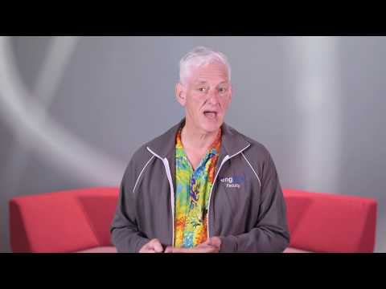
Peter Norvig é Diretor da Pesquisa no Google

Slide 20
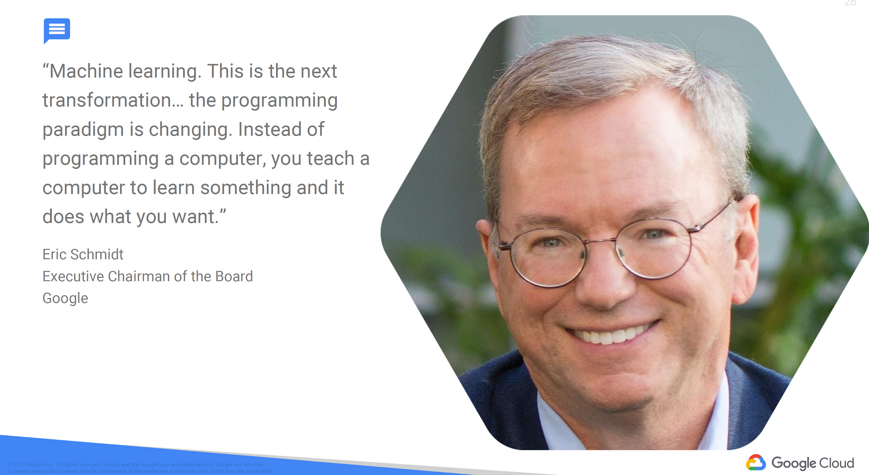

Slide 21
Programação lógica
Aprendizagem automática
Notes:
The electricity changed our society. Which area will not be transformed by AI ?
Andrew Ng (May, 2018) : https://www.youtube.com/watch?v=qnDlFTYnbR0

Slide 22
Framing

Slide 23
Objetivos
Conheça os termos fundamentais de aprendizado de máquina.
Explore vários usos do aprendizado de máquina.
Link : https://developers.google.com/machine-learning/crash-course/framing/video-lecture
Notes:
But why we use DLnow ? (answer scability, cad de s’améliorer avec l’augmentation des données)
http://jaejunyoo.blogspot.com/2017/03/nips-2016-tutorial-summary-nuts-and-bolts-of-building-AI-AndrewNg.html
Here is an interesting plot presenting the relationship between the data scale and the model performance, proposed by Andrew Ng in his “Nuts and Bolts of Applying Deep Learning” talk. On a small dataset, traditional algorithms (Regression, Random Forests, SVM, GBM, etc.) or statistical learning does a great job, but once the data scale goes up to the sky, the large NN outperforms others. Partially because compared to a traditional ML model, a neural network model has many more parameters and has the capability to learn complicated nonlinear patterns. Thus we expect the model to pick the most helpful features by itself without too much expert-involved manual feature engineering.
traditional does not improve with more data (the rise of data)
why more data ? Digitalization of the society processes (big data)

Slide 24
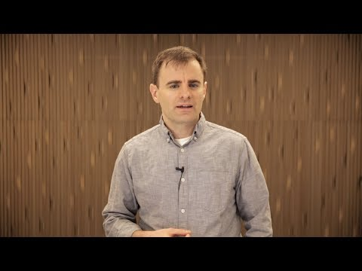
D. Sculley é Senior Staff Software Engineer no Google

Slide 25
ML Terminology
Supervised Learning (SL)
Labels
Features
Labeled or Unlabeled examples
Models (training, learning, inferences)
Regressão vs Classificação
Recursos : https://developers.google.com/machine-learning/crash-course/framing/ml-terminology

Slide 26
Check Your Understanding
Exercícios : https://developers.google.com/machine-learning/crash-course/framing/check-your-understanding
Supervised learning
Features and Labels

Slide 27
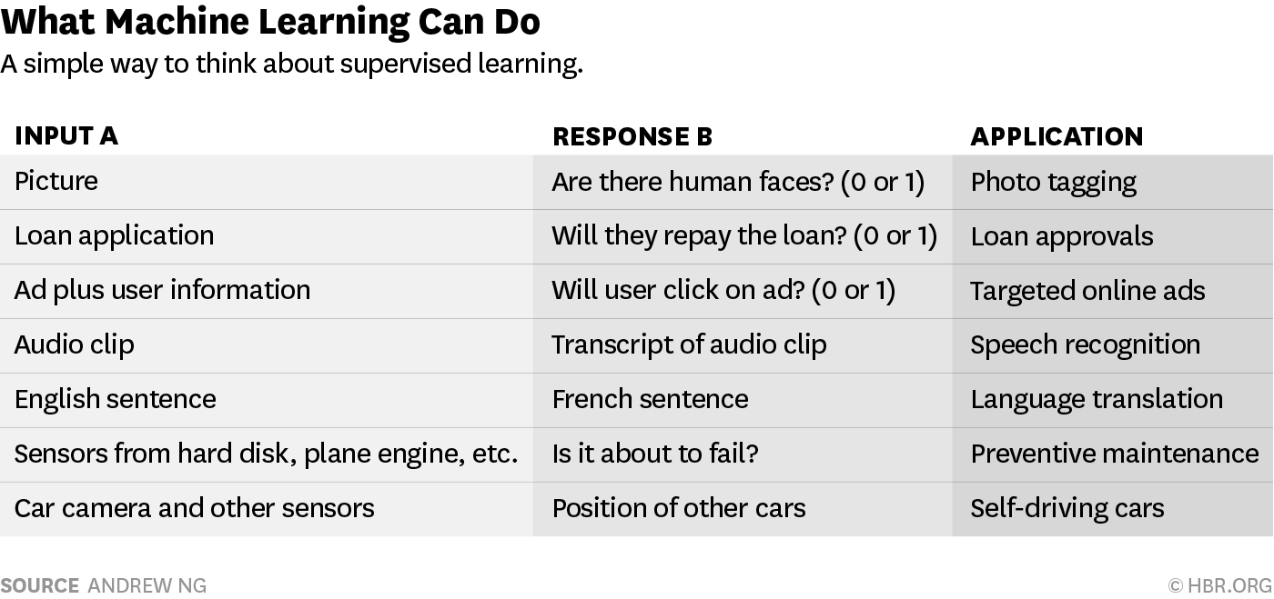
SL | Learning from AB mapping
IA
Notes:
What is SL ? it is learning outputs from inputs by learning an A to B mapping.
Not only numerical !
Advice : start with that (this can change all industries)
rule : everything that you just thinh menos de 1 se can be automated
input ----> output
A ---> B
mail spam (0/1)
(add, user) click ? (0/1)
audio transcript
text ----- traduction

Slide 28
99%
Supervised Learning
(learning from A ---> B mapping)

Slide 29
IA = aprendizagem automática com dados
A IA automatiza a decisão...
pelo treinamento supervisionado das máquinas a aprender a partir de dados rotulados.

Slide 30
Descending into ML

Slide 31
Objetivos
Atualize sua memória em Regressão Linear.
Relacionar pesos e vieses no aprendizado de máquina para inclinação e deslocamento no ajuste de linha.
Entenda "erro" em geral e “erro quadrado” em particular.
Link : https://developers.google.com/machine-learning/crash-course/descending-into-ml/video-lecture
Notes:
But why we use DLnow ? (answer scability, cad de s’améliorer avec l’augmentation des données)
http://jaejunyoo.blogspot.com/2017/03/nips-2016-tutorial-summary-nuts-and-bolts-of-building-AI-AndrewNg.html
Here is an interesting plot presenting the relationship between the data scale and the model performance, proposed by Andrew Ng in his “Nuts and Bolts of Applying Deep Learning” talk. On a small dataset, traditional algorithms (Regression, Random Forests, SVM, GBM, etc.) or statistical learning does a great job, but once the data scale goes up to the sky, the large NN outperforms others. Partially because compared to a traditional ML model, a neural network model has many more parameters and has the capability to learn complicated nonlinear patterns. Thus we expect the model to pick the most helpful features by itself without too much expert-involved manual feature engineering.
traditional does not improve with more data (the rise of data)
why more data ? Digitalization of the society processes (big data)

Slide 32
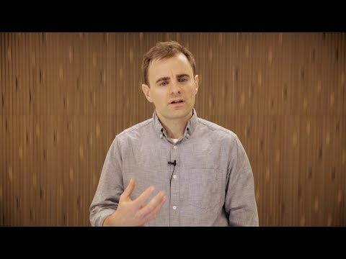
D. Sculley é Senior Staff Software Engineer no Google

Slide 33
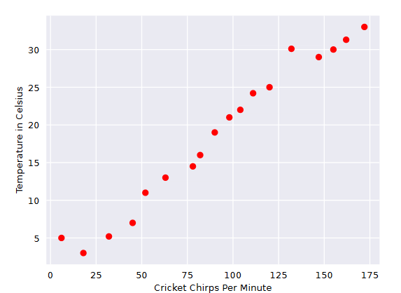
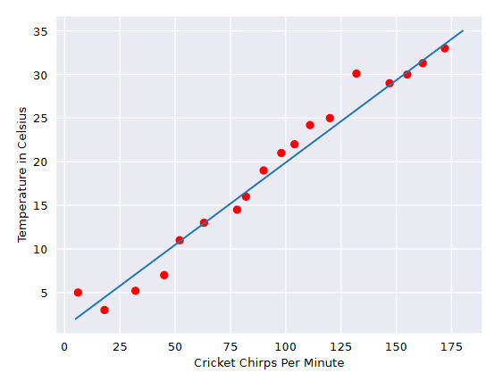
Linear Regression
Dados rotulados (x,y)
Modelo linear : y’ = b + w x

Slide 34
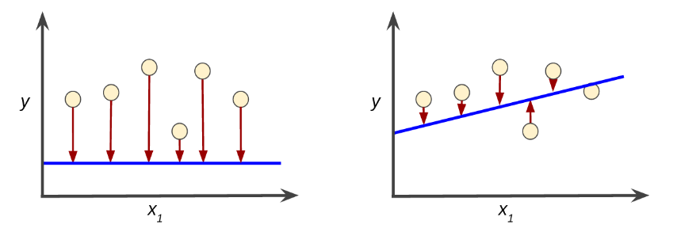
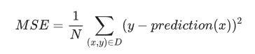
Training and Loss
High Loss
Low Loss

Slide 35
Check Your Understanding
Exercícios : https://developers.google.com/machine-learning/crash-course/descending-into-ml/check-your-understanding
Mean Squared Error

Slide 36
Reducing Loss

Slide 37
Objetivos
Descubra como treinar um modelo usando uma abordagem iterativa.
Entenda o Gradient Descent e variantes, incluindo:
mini-batch gradient descent
stochastic gradient descent
Experimente com Learning Rate.
Link : https://developers.google.com/machine-learning/crash-course/reducing-loss/video-lecture
Notes:
But why we use DLnow ? (answer scability, cad de s’améliorer avec l’augmentation des données)
http://jaejunyoo.blogspot.com/2017/03/nips-2016-tutorial-summary-nuts-and-bolts-of-building-AI-AndrewNg.html
Here is an interesting plot presenting the relationship between the data scale and the model performance, proposed by Andrew Ng in his “Nuts and Bolts of Applying Deep Learning” talk. On a small dataset, traditional algorithms (Regression, Random Forests, SVM, GBM, etc.) or statistical learning does a great job, but once the data scale goes up to the sky, the large NN outperforms others. Partially because compared to a traditional ML model, a neural network model has many more parameters and has the capability to learn complicated nonlinear patterns. Thus we expect the model to pick the most helpful features by itself without too much expert-involved manual feature engineering.
traditional does not improve with more data (the rise of data)
why more data ? Digitalization of the society processes (big data)

Slide 38
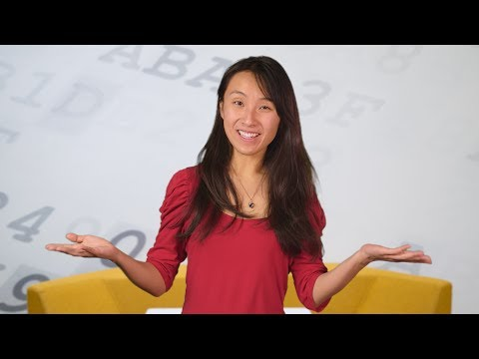
Cassandra Xia é desenvolvedora no Google

Slide 39
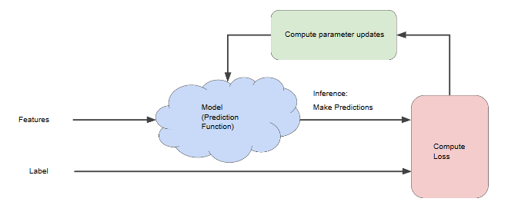
An interative approach

Slide 40
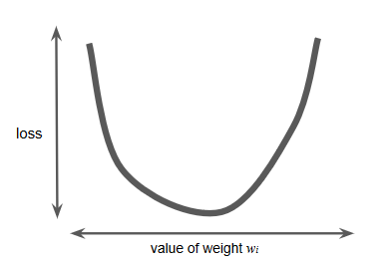
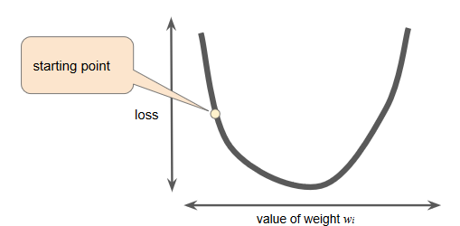
Gradient Descent

Slide 41
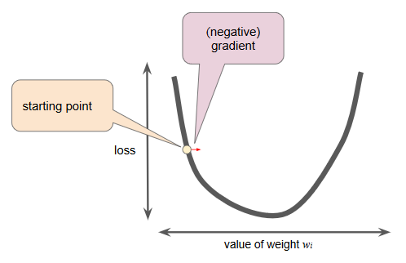
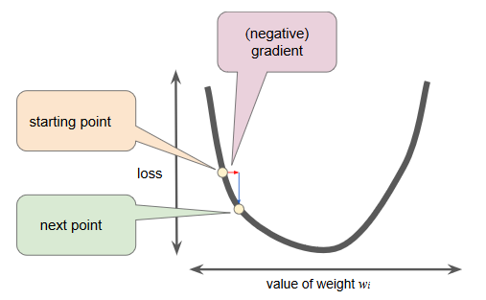
Gradient Descent

Slide 42
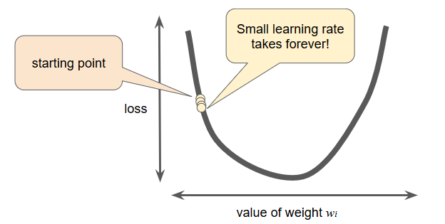
Learning Rate (too small)

Slide 43
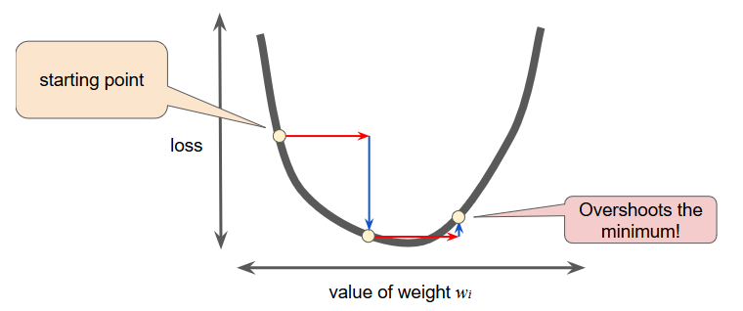
Learning Rate (too big)

Slide 44
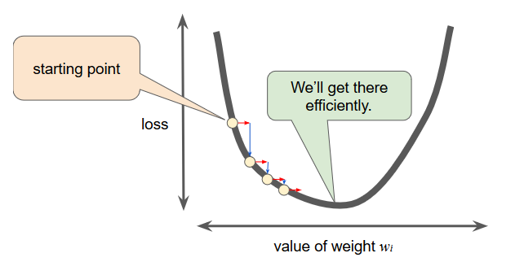
Learning Rate

Slide 45
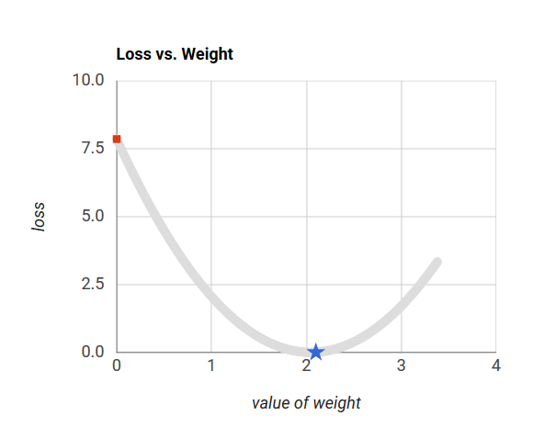
(exercise) Optimizing Learning Rate
https://developers.google.com/machine-learning/crash-course/fitter/graph

Slide 46
Stochastic Gradient Descent
Stochastic Gradient Descent (SGD) usa apenas um único exemplo por iteração.
Dado iterações suficientes, o SGD funciona, mas é muito barulhento. O termo "estocástico" indica que o exemplo que compreende cada lote é escolhido aleatoriamente.

Slide 47
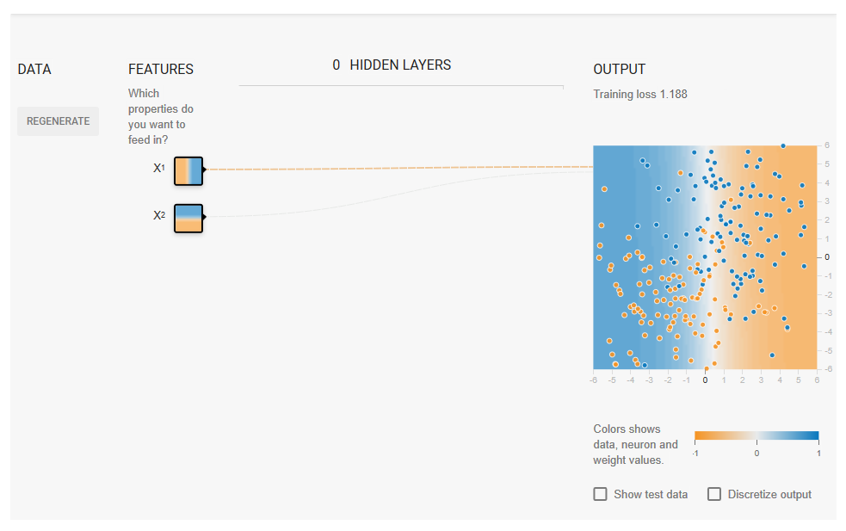
(exercise) Playground TensorFlow
https://developers.google.com/machine-learning/crash-course/reducing-loss/playground-exercise

Slide 48
Check Your Understanding
Exercícios : https://developers.google.com/machine-learning/crash-course/reducing-loss/check-your-understanding
Batch size

Slide 49
First steps
with TensorFlow

Slide 50
Objetivos
Aprenda como criar e modificar tensores no TensorFlow.
Aprenda o básico de Pandas.
Desenvolva código de Regressão Linear com uma das APIs de alto nível do TensorFlow.
Experimente com Learning Rate.
Link : https://developers.google.com/machine-learning/crash-course/first-steps-with-tensorflow/video-lecture
Notes:
But why we use DLnow ? (answer scability, cad de s’améliorer avec l’augmentation des données)
http://jaejunyoo.blogspot.com/2017/03/nips-2016-tutorial-summary-nuts-and-bolts-of-building-AI-AndrewNg.html
Here is an interesting plot presenting the relationship between the data scale and the model performance, proposed by Andrew Ng in his “Nuts and Bolts of Applying Deep Learning” talk. On a small dataset, traditional algorithms (Regression, Random Forests, SVM, GBM, etc.) or statistical learning does a great job, but once the data scale goes up to the sky, the large NN outperforms others. Partially because compared to a traditional ML model, a neural network model has many more parameters and has the capability to learn complicated nonlinear patterns. Thus we expect the model to pick the most helpful features by itself without too much expert-involved manual feature engineering.
traditional does not improve with more data (the rise of data)
why more data ? Digitalization of the society processes (big data)

Slide 51
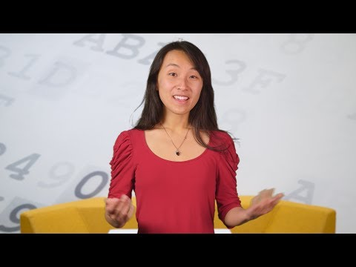
Cassandra Xia é desenvolvedora no Google

Slide 52
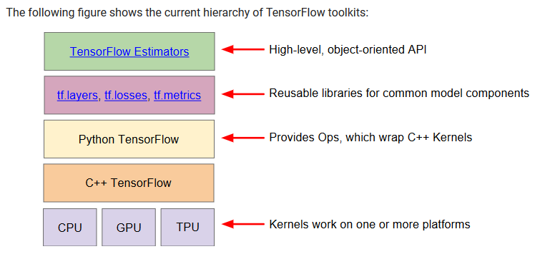
ToolKit

Slide 53
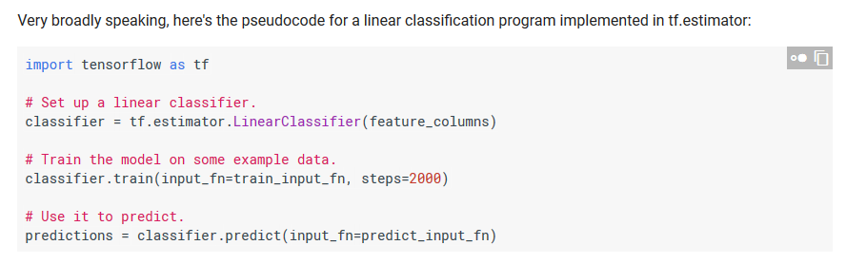
tf.estimator

Slide 54
Programming Exercises
Run the following three exercises in the provided order:
Quick Introduction to pandas. pandas is an important library for data analysis and modeling, and is widely used in TensorFlow coding. This tutorial provides all the pandas information you need for this course. If you already know pandas, you can skip this exercise.
First Steps with TensorFlow. This exercise explores linear regression.
Synthetic Features and Outliers. This exercise explores synthetic features and the effect of input outliers.

Slide 55
Machine Learning
vs
Deep Learning

Slide 56

Deep Learning não precisa de features engineering
Notes:
https://medium.com/@Say2neeraj/what-is-the-difference-between-machine-learning-and-deep-learning-5795e4415be9

Slide 57
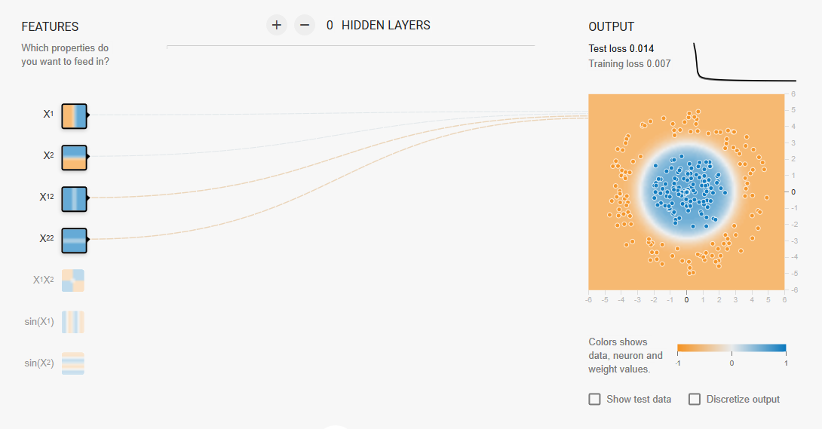
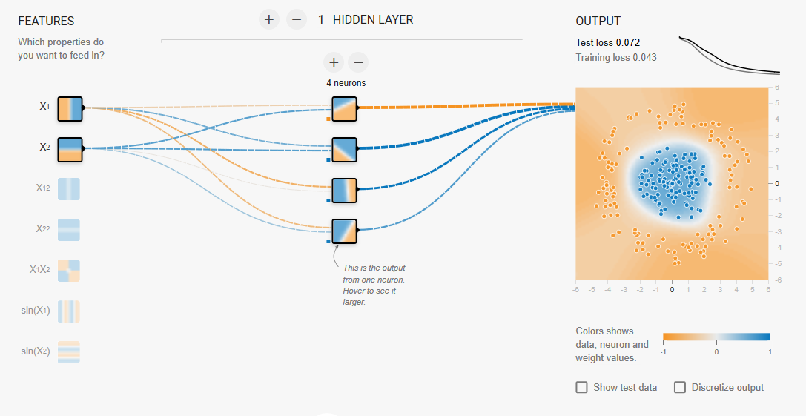
Machine Learning vs Deep Learning ?
Machine learning
COM features engineering
Deep learning
SEM features engineering
TensorFlow Playground : https://playground.tensorflow.org

Slide 58
Ciclo virtuoso da IA (ou como começar)
Dados
Usuários
Produto

Slide 59
Obrigado

